Slide 1
SECURE DATA HIDING IN IMAGES USING STEGAnOGRAPHY
SECURE THE DATA TO PREVENT HACKERS
Presented By: Sravya
Student Name: Gadwal Sravya
Department: Department of Commerce.
College Name: Dr. Jyothirmayi Degree college

Slide 2
OUTLINE
Problem Statement
Technology used
Wow factor
End users
Result
Conclusion
Git-hub Link
Future scope

Slide 3
Problem Statement
With the increasing need for secure communication and data privacy, the protection of sensitive information has become a critical concern. Traditional methods of data encryption often involve complex algorithms. In Steganography, hiding data within objects, such as images, has promising solutions. However, the challenge lies in ensuring the hidden data is not easily detectable while maintaining the integrity and quality of the host

Slide 4
Technology used
CV2, OS , String Libraries are used and
Platforms used “Python IDLE”.

Slide 5
Wow factors
“By combining security with steganography, advanced encryption, this project provides a more robust, secure, and practical solution compared to similar steganography projects.” and this project can stand out by incorporating unique features like adjusting different image complexities, robust encryption of hidden data before embedding and a user-friendly interface with flexible data types…..The main purpose of image steganography is to “hide the data in images”…..

Slide 6
End users
Intelligence agencies.
Businesses Application.
Journalists.
Individuals wanting to privately share confidential information.
Forensic Experts.

Slide 7
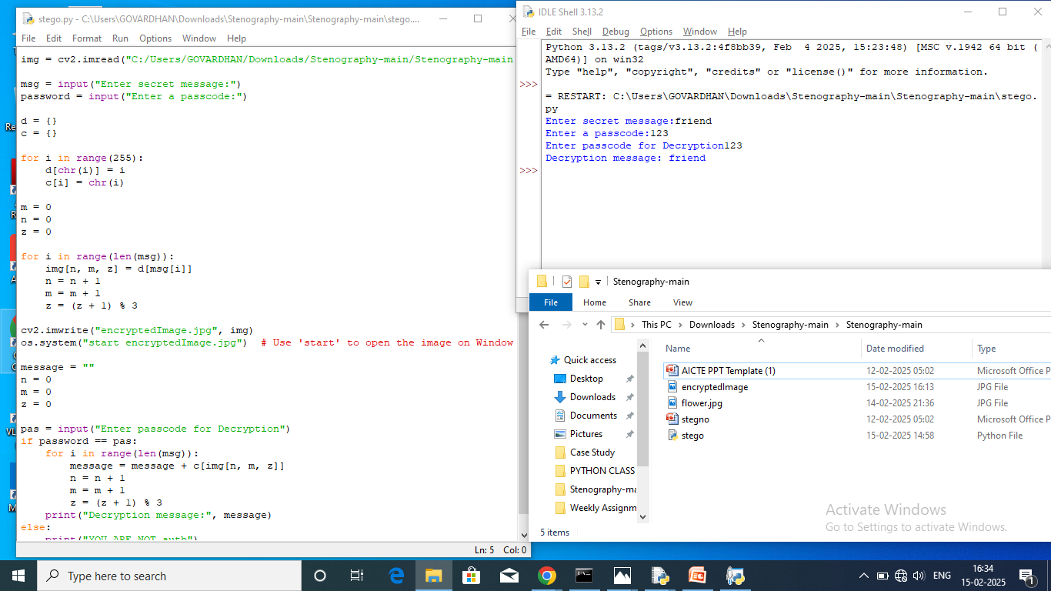
Results

Slide 8
Conclusion
I conclude that my project on “Secure data hiding in images using Steganography successfully addressed the key problem of discreetly embedding sensitive information within normal photos and providing a conversion channel for secure communication while maintaining visual integrity….

Slide 9
GitHub Link
https://github.com/Gadwal24/Secure-data-hiding-in-images-using-Steganography.git
https://github.com/Gadwal24/Secure-data-hiding-in-images-using-Steganography

Slide 10
Future scope(optional)
The future scope of secure data hiding in images using steganography is vast, especially as both technology and security and some key direction in this field is likely to be Advanced Security, multimedia steganography, etc… and developing more robust and adaptive techniques that can effectively conceal sensitive information within images…

Slide 11
THANK YOU
Gadwal Sravya
Department of Commerce
Dr. Jyothirmayi Degree college

